Slide 1
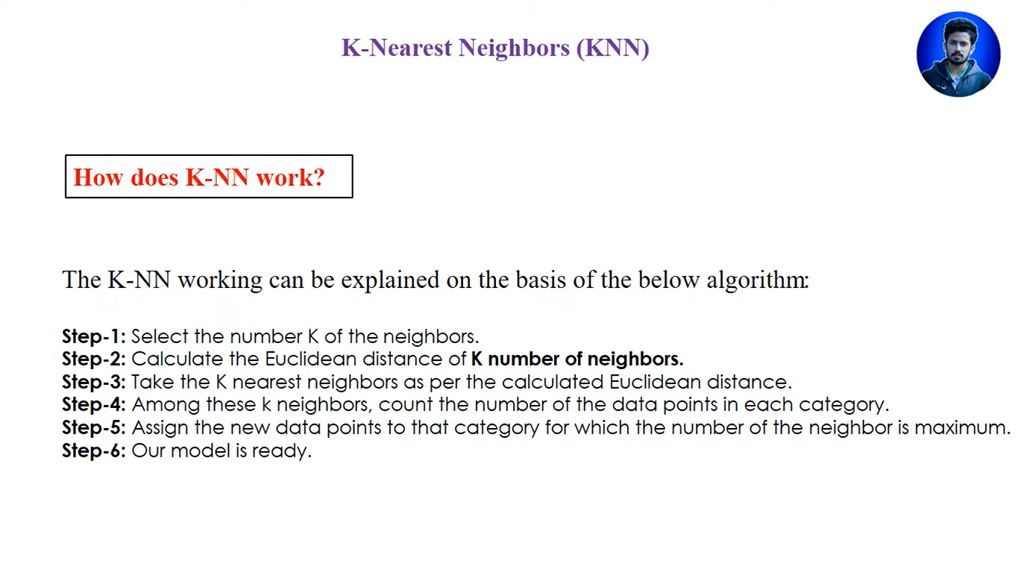

Optimal K value: $\sqrt{Total data point}$

Slide 2
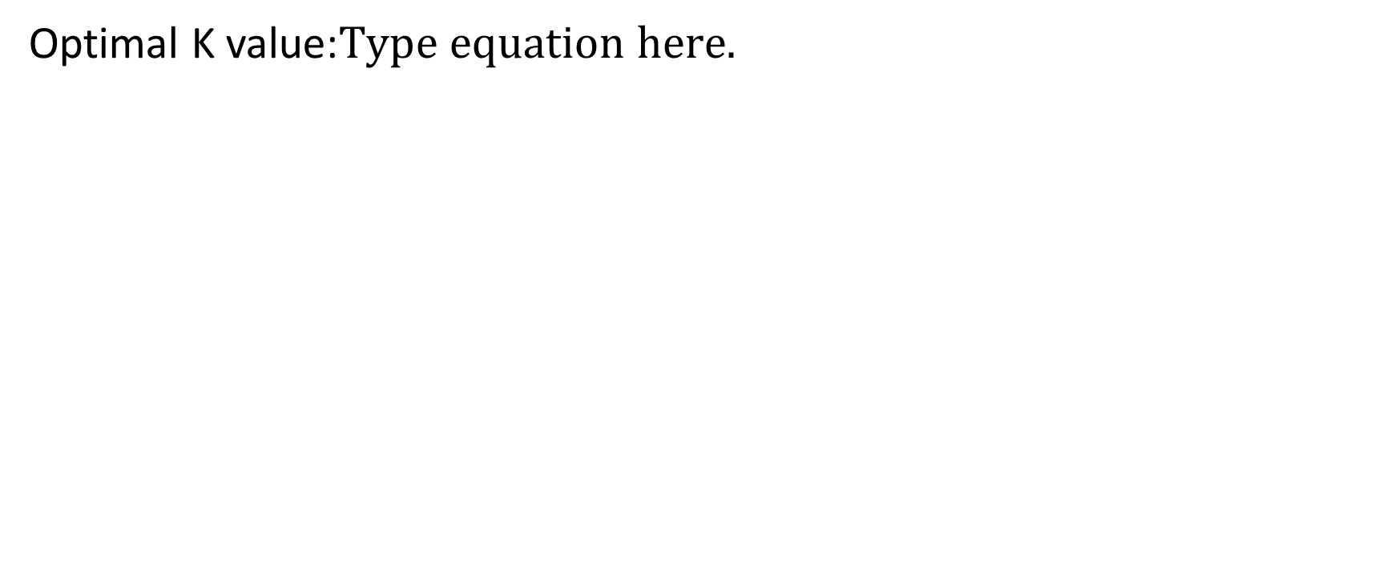
Optimal K value:

Slide 3
